Slide 1
High Flux Backscattering Spectrometer (HFBS)
Methyl Group Dynamics in Fluorotoluene
Group 1

Slide 2
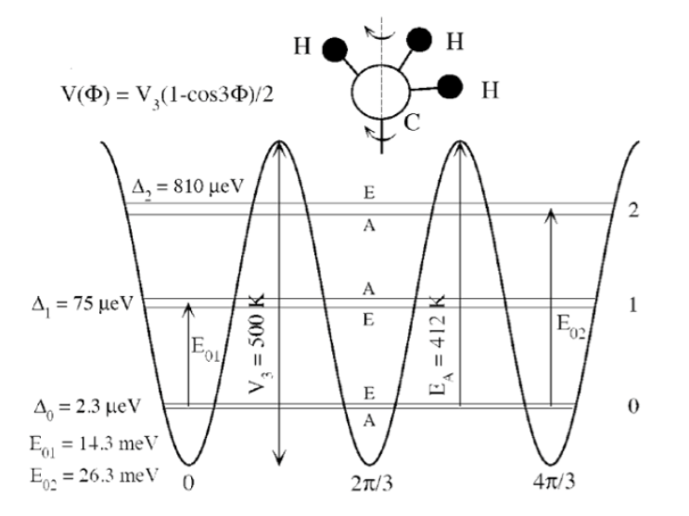
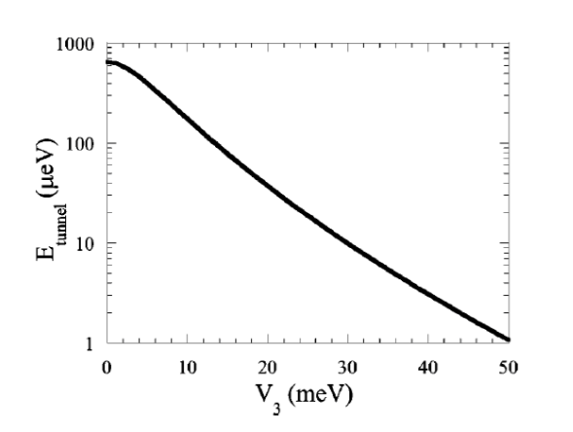
Motivation
How do we observe the quantum tunneling of the methyl group?
Rotational Energy of Methyl Group
￼
Monoclinic crystal formation at right conditions
Tunneling energy as a function of barrier energy

Slide 3
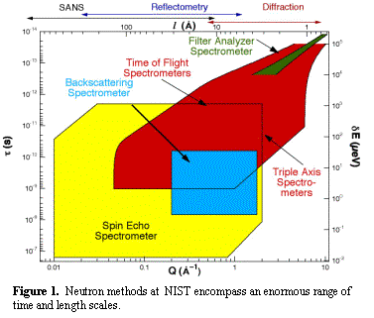


Why High Flux Backscattering?
vanishes!
i)
High energy resolution (1 μeV)
ii)
Increases effective flux at sample almost 4 times
iii)
Dynamic Range:
25 Å ~ 3.6 Å
10 ns ~ 0.1 ns

Slide 4
Backscattering for Neutrons
Analyzers
reflect only 6.27 Å
Cold source
Velocity selector
Sample
scatters different
Q
E
PST
Detectors
Monochromator
reflects only 6.27 Å
no energy transfer yet

Slide 5
Fixed window scans
Quick overview of motions present in the system
Liquid-solid transition observed
Additional motions observed at much lower T
liquid-solid transition

Slide 6
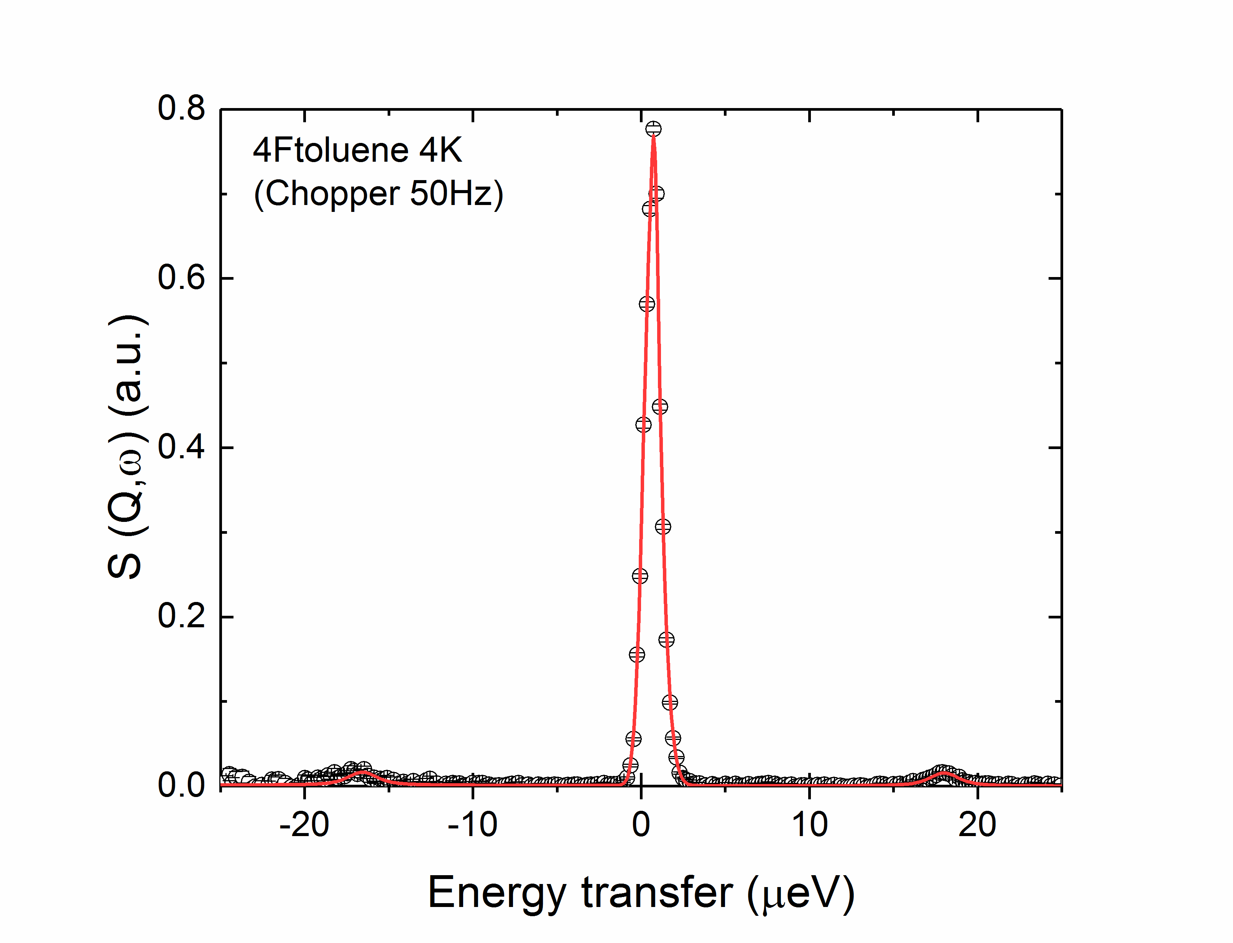
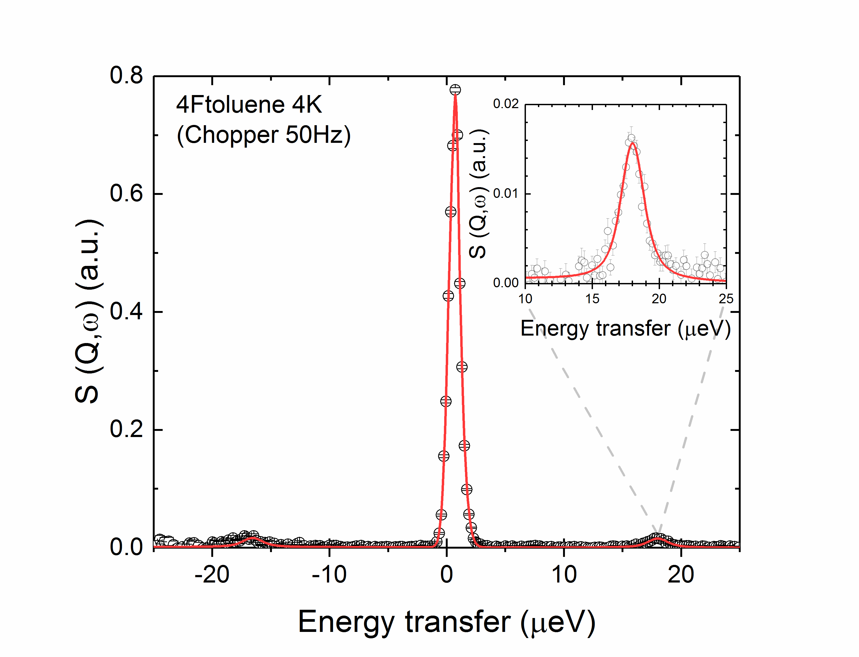
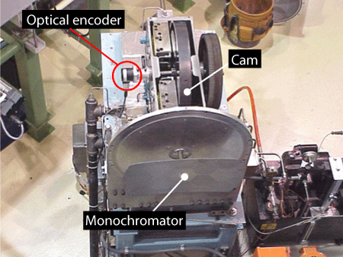
QENS
Analyzers reflect 6.27 Å
Intensity
Velocity
selector
Elastic
Elastic
Sample
Quasielastic
Monochromator
PST
Detectors
Inelastic
Inelastic
Energy
Dynamic Range

Slide 7
Data analysis

Slide 8
Temperature Dependence of Dynamics
Rotational tunneling to rotational jump diffusion
Quantum to classical transition
Coupling between methyl groups and phonons
S (E) [a.u.]
E [μeV]

Slide 9
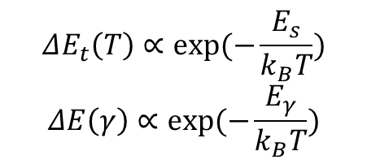
Arrhenius Equation Fit
$$ΔE_{t}\left(T\right)∝exp⁡(−\frac{E_{s}}{k_{B}T})$$
$$ΔE\left(γ\right)∝exp(−\frac{E_{γ}}{k_{B}T})$$
 | Ea (meV) (Peak Shift) | Ea (meV) (Width Shift)
High T | 7.4 | 9.4
Low T | 7.64 | 10.3
E (meV)
Phonon Energy States
Ground state to first energy state transition ~ 12.3 meV
9

Slide 10
Acknowledgements
Madhusudan Tyagi
Timothy Prisk
Yamali Hernandez
Alex Grutter
Entire Summer School Team

Slide 11
High Flux Backscattering Spectrometer (HFBS)
Methyl Group Dynamics in Fluorotoluene
Group 1

